Slide 1
Paradoxes
PH1102E/GEK1067
Week 13

Slide 2
A paradox is “an apparently unacceptable conclusion derived by apparently acceptable reasoning from apparently acceptable premises.”
-- R.M. Sainsbury, Paradoxes
(Cambridge University Press, 2009)

Slide 3
Paradoxes have played an important role in logic, math, science, and philosophy.
Why?
Because in order to solve a paradox, you have to give up a belief that seems obviously true when you first think about it.
Often, this is a belief that logicians, mathematicians, scientists, or philosophers have been taking for granted for a long time.

Slide 4
Newcomb’s paradox

Slide 5
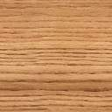
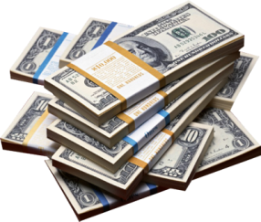
Box A
$1,000
Box B
$0 or $1,000,000
Notes:
If Predictor predicted you would choose B, he put $1,000,000 in B. If Predictor predicted you would choose both boxes, he put $0 in B.

Slide 6
Do you choose to take both boxes, or just Box B?
Box A
$1,000
Box B
$0 or $1,000,000
Notes:
If Predictor predicted you would choose B, he put $1,000,000 in B. If Predictor predicted you would choose both boxes, he put $0 in B.

Slide 7
“Take Box B only”

Slide 8
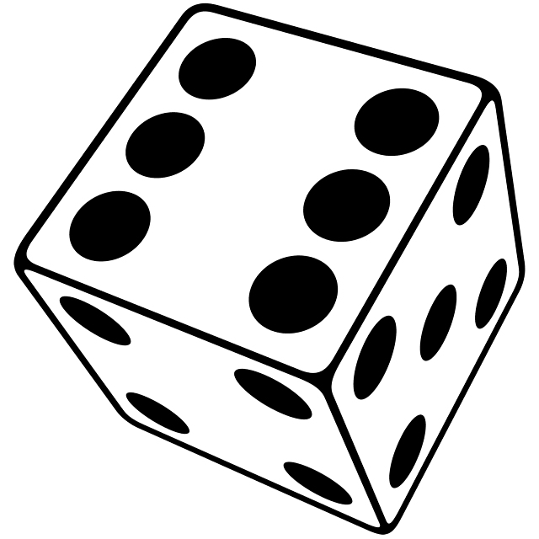
On a roll of 1, 2, or 3, you pay me $1.
On a roll of 4, 5, or 6, I pay you $2.

Slide 9
On a roll of 1, 2, or 3, you pay me $1.
On a roll of 4, 5, or 6, I pay you $2.

Slide 10
Expected Utility Reasoning
 | 1, 2, or 3 gets rolled. Likelihood: 50% | 4, 5, or 6 gets rolled. Likelihood: 50%
Take bet. | -$1.00 | +$2.00
Don’t take bet. | $0 | $0

Slide 11
Expected Utility Reasoning
 | 1, 2, or 3 gets rolled. Likelihood: 50% | 4, 5, or 6 gets rolled. Likelihood: 50%
Take bet. | -$1.00 | +$2.00
Don’t take bet. | $0 | $0

Slide 12
Expected Utility Reasoning
 | 1, 2, or 3 gets rolled. Likelihood: 50% | 4, 5, or 6 gets rolled. Likelihood: 50%
Take bet. | -$1.00 | +$2.00
Don’t take bet. | $0 | $0

Slide 13
Expected Utility Reasoning
 | 1, 2, or 3 gets rolled. Likelihood: 50% | 4, 5, or 6 gets rolled. Likelihood: 50%
Take bet. | -$1 | +$2.00
Don’t take bet.

Slide 14
Expected Utility Reasoning
 | 1, 2, or 3 gets rolled. Likelihood: 50% | 4, 5, or 6 gets rolled. Likelihood: 50%
Take bet. | -$1 | +$2
Don’t take bet.

Slide 15
Expected Utility Reasoning
 | 1, 2, or 3 gets rolled. Likelihood: 50% | 4, 5, or 6 gets rolled. Likelihood: 50%
Take bet. | -$1 | +$2
Don’t take bet. | $0 | $0

Slide 16
Expected Utility Reasoning
 | 1, 2, or 3 gets rolled. Likelihood: 50% | 4, 5, or 6 gets rolled. Likelihood: 50%
Take bet. | -$1 | +$2
Don’t take bet. | $0 | $0

Slide 17
Expected Utility Reasoning
 | 1, 2, or 3 gets rolled. Likelihood: 50% | 4, 5, or 6 gets rolled. Likelihood: 50%
Take bet. | -$1 | +$2
Don’t take bet. | $0 | $0

Slide 18
Expected Utility Reasoning
 | 1, 2, or 3 gets rolled. Likelihood: 50% | 4, 5, or 6 gets rolled. Likelihood: 50%
Take bet. | -$0.50 | +$2
Don’t take bet. | $0 | $0

Slide 19
Expected Utility Reasoning
 | 1, 2, or 3 gets rolled. Likelihood: 50% | 4, 5, or 6 gets rolled. Likelihood: 50%
Take bet. | -$0.50 | +$2
Don’t take bet. | $0 | $0
risk-adjusted loss

Slide 20
Expected Utility Reasoning
 | 1, 2, or 3 gets rolled. Likelihood: 50% | 4, 5, or 6 gets rolled. Likelihood: 50%
Take bet. | -$0.50 | +$2
Don’t take bet. | $0 | $0
risk-adjusted loss

Slide 21
Expected Utility Reasoning
 | 1, 2, or 3 gets rolled. Likelihood: 50% | 4, 5, or 6 gets rolled. Likelihood: 50%
Take bet. | -$0.50 | +$1
Don’t take bet. | $0 | $0
risk-adjusted loss

Slide 22
Expected Utility Reasoning
 | 1, 2, or 3 gets rolled. Likelihood: 50% | 4, 5, or 6 gets rolled. Likelihood: 50%
Take bet. | -$0.50 | +$1
Don’t take bet. | $0 | $0
risk-adjusted loss
risk-adjusted gain

Slide 23
Expected Utility Reasoning
 | 1, 2, or 3 gets rolled. Likelihood: 50% | 4, 5, or 6 gets rolled. Likelihood: 50%
Take bet. | -$0.50 | +$1 | +$0.50
Don’t take bet. | $0 | $0
risk-adjusted loss
risk-adjusted gain

Slide 24
Expected Utility Reasoning
 | 1, 2, or 3 gets rolled. Likelihood: 50% | 4, 5, or 6 gets rolled. Likelihood: 50%
Take bet. | -$0.50 | +$1 | +$0.50
Don’t take bet. | $0 | $0
risk-adjusted loss
risk-adjusted gain
expected value of taking the bet =
(risk adjusted loss) + (risk adjusted gain)

Slide 25
Expected Utility Reasoning
 | 1, 2, or 3 gets rolled. Likelihood: 50% | 4, 5, or 6 gets rolled. Likelihood: 50% | Expected value of your decision
Take bet. | -$0.50 | +$1 | +$0.50
Don’t take bet. | $0 | $0
risk-adjusted loss
risk-adjusted gain
expected value of taking the bet =
(risk adjusted loss) + (risk adjusted gain)

Slide 26
Expected Utility Reasoning
 | 1, 2, or 3 gets rolled. Likelihood: 50% | 4, 5, or 6 gets rolled. Likelihood: 50% | Expected value of your decision
Take bet. | -$0.50 | +$1 | +$0.50
Don’t take bet. | $0 | $0

Slide 27
Expected Utility Reasoning
 | 1, 2, or 3 gets rolled. Likelihood: 50% | 4, 5, or 6 gets rolled. Likelihood: 50% | Expected value of your decision
Take bet. | -$0.50 | +$1 | +$0.50
Don’t take bet. | $0 | $0 | $0
Notes:
You should be willing to pay up to 50 cents to play this game.

Slide 28
Expected Utility Reasoning
 | 1, 2, or 3 gets rolled. Likelihood: 50% | 4, 5, or 6 gets rolled. Likelihood: 50% | Expected value of your decision
Take bet. | -$0.50 | +$1 | +$0.50
Don’t take bet. | $0 | $0 | $0
A rational person will make the decision that has the highest expected value (or “expected utility”).
Notes:
You should be willing to pay up to 50 cents to play this game.

Slide 29
Do you choose to take both boxes, or just Box B?
Box A
$1,000
Box B
$0 or $1,000,000
Notes:
If Predictor predicted you would choose B, he put $1,000,000 in B. If Predictor predicted you would choose both boxes, he put $0 in B.

Slide 30
“Take Box B only!”
Box A
$1,000
Box B
$0 or $1,000,000
Notes:
If Predictor predicted you would choose B, he put $1,000,000 in B. If Predictor predicted you would choose both boxes, he put $0 in B.

Slide 31
“Take Box B only!”
 | Predictor predicted your choice correctly Likelihood: 90% | Predictor predicted your choice incorrectly Likelihood: 10% | Expected value of your decision
Take Box B only. | +$1,000,000 | $0 | +$900,000
Take both boxes. | +$1,000 | +$1,001,000 | +$101,000

Slide 32
“Take Box B only!”
 | Predictor predicted your choice correctly Likelihood: 90% | Predictor predicted your choice incorrectly Likelihood: 10% | Expected value of your decision
Take Box B only. | +$1,000,000 | $0 | +$900,000
Take both boxes. | +$1,000 | +$1,001,000 | +$101,000

Slide 33
“Take Box B only!”
 | Predictor predicted your choice correctly Likelihood: 90% | Predictor predicted your choice incorrectly Likelihood: 10% | Expected value of your decision
Take Box B only. | +$1,000,000 | $0 | +$900,000
Take both boxes. | +$1,000 | +$1,001,000 | +$101,000

Slide 34
“Take Box B only!”
 | Predictor predicted your choice correctly Likelihood: 90% | Predictor predicted your choice incorrectly Likelihood: 10% | Expected value of your decision
Take Box B only. | +$1,000,000 | $0 | +$900,000
Take both boxes. | +$1,000 | +$1,001,000 | +$101,000

Slide 35
“Take Box B only!”
 | Predictor predicted your choice correctly Likelihood: 90% | Predictor predicted your choice incorrectly Likelihood: 10% | Expected value of your decision
Take Box B only. | +$1,000,000 | $0 | +$900,000
Take both boxes. | +$1,000 | +$1,001,000 | +$101,000

Slide 36
“Take Box B only!”
 | Predictor predicted your choice correctly Likelihood: 90% | Predictor predicted your choice incorrectly Likelihood: 10% | Expected value of your decision
Take Box B only. | +$1,000,000 | $0 | +$900,000
Take both boxes. | +$1,000 | +$1,001,000 | +$101,000

Slide 37
“Take Box B only!”
 | Predictor predicted your choice correctly Likelihood: 90% | Predictor predicted your choice incorrectly Likelihood: 10% | Expected value of your decision
Take Box B only. | +$1,000,000 | $0 | +$900,000
Take both boxes. | +$1,000 | +$1,001,000 | +$101,000

Slide 38
“Take Box B only!”
 | Predictor predicted your choice correctly Likelihood: 90% | Predictor predicted your choice incorrectly Likelihood: 10% | Expected value of your decision
Take Box B only. | +$1,000,000 | $0 | +$900,000
Take both boxes. | +$1,000 | +$1,001,000 | +$101,000

Slide 39
“Take Box B only!”
 | Predictor predicted your choice correctly Likelihood: 90% | Predictor predicted your choice incorrectly Likelihood: 10% | Expected value of your decision
Take Box B only. | +$1,000,000 | $0 | +$900,000
Take both boxes. | +$1,000 | +$1,001,000 | +$101,000
Expected utility reasoning demands that you take only the opaque box!

Slide 41
Do you choose to take both boxes, or just Box B?
Box A
$1,000
Box B
$0 or $1,000,000
Notes:
If Predictor predicted you would choose B, he put $1,000,000 in B. If Predictor predicted you would choose both boxes, he put $0 in B.

Slide 42
“Take both boxes!”
Box A
$1,000
Box B
$0 or $1,000,000
Notes:
If Predictor predicted you would choose B, he put $1,000,000 in B. If Predictor predicted you would choose both boxes, he put $0 in B.

Slide 43
“Take both boxes!”
 | Predictor predicted you would take just one box. | Predictor predicted that you would take both boxes.
Take Box B only. | +$1,000,000 | $0
Take both boxes. | +$1,001,000 | +$1,000

Slide 44
“Take both boxes!”
 | Predictor predicted you would take Box B only. | Predictor predicted that you would take both boxes.
Take Box B only. | +$1,000,000 | $0
Take both boxes. | +$1,001,000 | +$1,000

Slide 45
“Take both boxes!”
 | Predictor predicted you would take Box B only. | Predictor predicted that you would take both boxes.
Take Box B only. | +$1,000,000 | $0
Take both boxes. | +$1,001,000 | +$1,000

Slide 46
“Take both boxes!”
 | Predictor predicted you would take Box B only. | Predictor predicted that you would take both boxes.
Take Box B only. | +$1,000,000 | $0
Take both boxes. | +$1,001,000 | +$1,000

Slide 47
“Take both boxes!”
 | Predictor predicted you would take Box B only. | Predictor predicted that you would take both boxes.
Take Box B only. | +$1,000,000 | $0
Take both boxes. | +$1,001,000 | +$1,000
Regardless of what the Predictor predicted, you’ll end up with more money if you take both boxes than if you take only Box B!

Slide 48
Do you choose to take both boxes, or just Box B?
Box A
$1,000
Box B
$0 or $1,000,000
Notes:
If Predictor predicted you would choose B, he put $1,000,000 in B. If Predictor predicted you would choose both boxes, he put $0 in B.

Slide 49
???
Box A
$1,000
Box B
$0 or $1,000,000
Notes:
If Predictor predicted you would choose B, he put $1,000,000 in B. If Predictor predicted you would choose both boxes, he put $0 in B.

Slide 51
Russell’s paradox

Slide 52
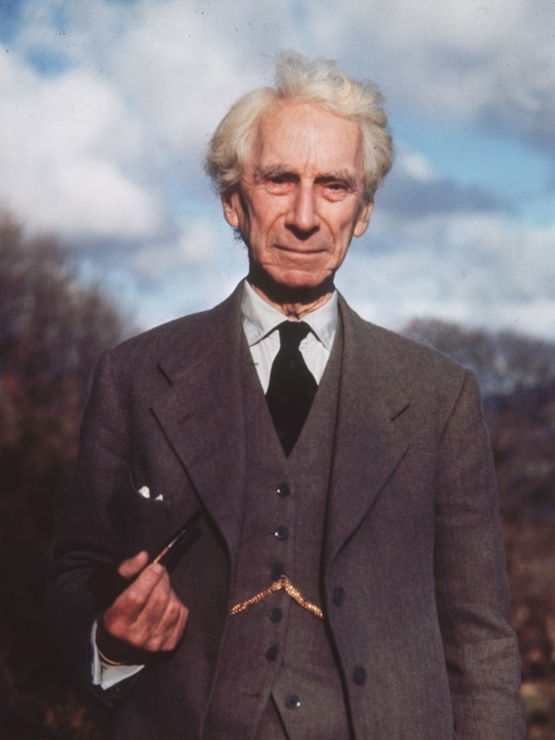
Russell’s Paradox
Bertrand Russell
(1872-1970)

Slide 53
Russell’s Paradox
A set is any collection of things.
A set’s members are the things in the set.
The concepts of set and set membership are central to logic and mathematics.
Bertrand Russell
(1872-1970)

Slide 54
Russell’s Paradox
Some sets are members of themselves, others are not.
Non-self-membered: the set of all elephants.
Self-membered: the set of all sets that have more than three members.
Bertrand Russell
(1872-1970)

Slide 55
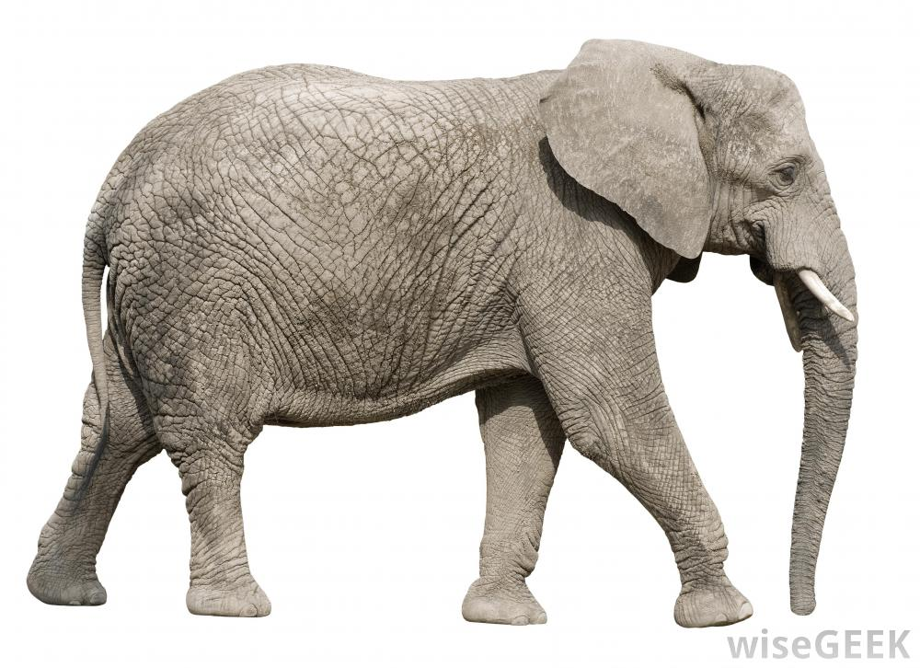
The set of all elephants is not a member of itself, since the set of all elephants is not an elephant.
The set of all elephants is not one of these.

Slide 56
The set of all elephants is not a member of itself, since the set of all elephants is not an elephant.
The set of all sets that have more than three members is a member of itself, since there are more than three sets that have more than three members:
The set of all elephants
The set of all nations
The set of all students
The set of all planets
Etc.
The set of all elephants is not one of these.

Slide 57
Russell’s Paradox
Consider the set of all non-self-membered sets; call this set S.
Is S a member of itself?
If the answer is Yes, then S is both non-self-membered (since it belongs to the set of all non-self-membered sets) and self-membered (since it is a member of itself). This is impossible.
If the answer is No, then S is both self-membered (since it then belongs to the set of non-self-membered sets i.e. S) and non-self-membered (since it is not a member of itself). This is also impossible.
So S neither is nor is not a member of itself?!?
Bertrand Russell
(1872-1970)

Slide 58
Russell’s Paradox
Consider the set of all non-self-membered sets; call this set S.
Is S a member of itself?
If the answer is Yes, then S is both non-self-membered (since it belongs to the set of all non-self-membered sets) and self-membered (since it is a member of itself). This is impossible.
If the answer is No, then S is both self-membered (since it then belongs to the set of non-self-membered sets i.e. S) and non-self-membered (since it is not a member of itself). This is also impossible.
So S neither is nor is not a member of itself?!?
Bertrand Russell
(1872-1970)

Slide 59
Russell’s Paradox
Consider the set of all non-self-membered sets; call this set S.
Is S a member of itself?
If the answer is Yes, then S is both non-self-membered (since it belongs to the set of all non-self-membered sets) and self-membered (since it is a member of itself). This is impossible.
If the answer is No, then S is both self-membered (since it then belongs to the set of non-self-membered sets i.e. S) and non-self-membered (since it is not a member of itself). This is also impossible.
So S neither is nor is not a member of itself?!?
Bertrand Russell
(1872-1970)

Slide 60
Russell’s Paradox
Consider the set of all non-self-membered sets; call this set S.
Is S a member of itself?
If the answer is Yes, then S is both non-self-membered (since it belongs to the set of all non-self-membered sets) and self-membered (since it is a member of itself). This is impossible.
If the answer is No, then S is both self-membered (since it then belongs to the set of non-self-membered sets i.e. S) and non-self-membered (since it is not a member of itself). This is also impossible.
So S neither is nor is not a member of itself?!?
Bertrand Russell
(1872-1970)

Slide 61
Russell’s Paradox
Consider the set of all non-self-membered sets; call this set S.
Is S a member of itself?
If the answer is Yes, then S is both non-self-membered (since it belongs to the set of all non-self-membered sets) and self-membered (since it is a member of itself). This is impossible.
If the answer is No, then S is both self-membered (since it then belongs to the set of non-self-membered sets i.e. S) and non-self-membered (since it is not a member of itself). This is also impossible.
So S neither is nor is not a member of itself?!?
Bertrand Russell
(1872-1970)

Slide 63
A paradox of value

Slide 65



Slide 67


Slide 74


Slide 78
Which is scenario better? The scenario that contains
the Sphere of Joy
or,
the Sphere of Misery
Which is better? A scenario in which
there is always more joy than misery
or,
there is always more misery than joy

Slide 79
Which is scenario better? The scenario that contains
the Sphere of Joy
or,
the Sphere of Misery
Which is better? A scenario in which
there is always more joy than misery
or,
there is always more misery than joy

Slide 80
The Sphere of Joy scenario is better than the Sphere of Misery scenario.
But in the Sphere of Joy scenario there is always more misery than joy, and in the Sphere of Misery scenario there is always more joy than misery.
And a scenario in which there is always more joy than misery is better than a scenario in which there is always more misery than joy.
So, the Sphere of Misery scenario is better than the Sphere of Joy scenario. (follows from 2 and 3)
So, the Sphere of Joy scenario is better than the Sphere of Misery scenario, and the Sphere of Misery scenario is better than the Sphere of Joy scenario. (follows from 1 and 2) ?!?

Slide 82
Sorites paradox

Slide 83
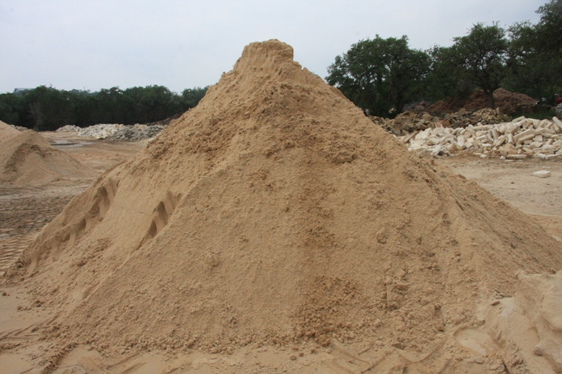
Sandra
(a million-grain heap of sand)

Slide 84
If something is a heap of sand, it remains a heap of sand if you remove one grain of sand from it.
Sandra is a heap of sand.
So, Sandra-minus-one-grain is a heap of sand. (follows from 1 and 2).
So, Sandra-minus-two-grains is a heap of sand. (follows from 1 and 3)
So, Sandra-minus-three-grains is a heap of sand. (follows from 1 and 4)
⋮
1,000,000. So, Sandra-minus-999,998-grains is a heap of sand. (follows from 1 and 999,999)
1,000,001. So, Sandra-minus-999,999-grains is a heap of sand. (follows from 1 and 1,000,000)

Slide 85
If something is a heap of sand, it remains a heap of sand if you remove one grain of sand from it.
Sandra is a heap of sand.
So, Sandra-minus-one-grain is a heap of sand. (follows from 1 and 2).
So, Sandra-minus-two-grains is a heap of sand. (follows from 1 and 3)
So, Sandra-minus-three-grains is a heap of sand. (follows from 1 and 4)
⋮
1,000,000. So, Sandra-minus-999,998-grains is a heap of sand. (follows from 1 and 999,999)
1,000,001. So, Sandra-minus-999,999-grains is a heap of sand. (follows from 1 and 1,000,000)

Slide 86
If something is a heap of sand, it remains a heap of sand if you remove one grain of sand from it.
Sandra is a heap of sand.
So, Sandra-minus-one-grain is a heap of sand. (follows from 1 and 2).
So, Sandra-minus-two-grains is a heap of sand. (follows from 1 and 3)
So, Sandra-minus-three-grains is a heap of sand. (follows from 1 and 4)
⋮
1,000,000. So, Sandra-minus-999,998-grains is a heap of sand. (follows from 1 and 999,999)
1,000,001. So, Sandra-minus-999,999-grains is a heap of sand. (follows from 1 and 1,000,000)

Slide 87
If something is a heap of sand, it remains a heap of sand if you remove one grain of sand from it.
Sandra is a heap of sand.
So, Sandra-minus-one-grain is a heap of sand. (follows from 1 and 2).
So, Sandra-minus-two-grains is a heap of sand. (follows from 1 and 3)
So, Sandra-minus-three-grains is a heap of sand. (follows from 1 and 4)
⋮
1,000,000. So, Sandra-minus-999,998-grains is a heap of sand. (follows from 1 and 999,999)
1,000,001. So, Sandra-minus-999,999-grains is a heap of sand. (follows from 1 and 1,000,000)

Slide 88
If something is a heap of sand, it remains a heap of sand if you remove one grain of sand from it.
Sandra is a heap of sand.
So, Sandra-minus-one-grain is a heap of sand. (follows from 1 and 2).
So, Sandra-minus-two-grains is a heap of sand. (follows from 1 and 3)
So, Sandra-minus-three-grains is a heap of sand. (follows from 1 and 4)
⋮
1,000,000. So, Sandra-minus-999,998-grains is a heap of sand. (follows from 1 and 999,999)
1,000,001. So, Sandra-minus-999,999-grains is a heap of sand. (follows from 1 and 1,000,000)

Slide 89
If something is a heap of sand, it remains a heap of sand if you remove one grain of sand from it.
Sandra is a heap of sand.
So, Sandra-minus-one-grain is a heap of sand. (follows from 1 and 2).
So, Sandra-minus-two-grains is a heap of sand. (follows from 1 and 3)
So, Sandra-minus-three-grains is a heap of sand. (follows from 1 and 4)
⋮
1,000,000. So, Sandra-minus-999,998-grains is a heap of sand. (follows from 1 and 999,999)
1,000,001. So, Sandra-minus-999,999-grains is a heap of sand. (follows from 1 and 1,000,000)

Slide 90


A heap of sand?

Slide 91
If something is a heap of sand, it remains a heap of sand if you remove one grain of sand from it.
Sandra is a heap of sand.
So, Sandra-minus-one-grain is a heap of sand. (follows from 1 and 2).
So, Sandra-minus-two-grains is a heap of sand. (follows from 1 and 3)
So, Sandra-minus-three-grains is a heap of sand. (follows from 1 and 4)
⋮
1,000,000. So, Sandra-minus-999,998-grains is a heap of sand. (follows from 1 and 999,999)
1,000,001. So, Sandra-minus-999,999-grains is a heap of sand. (follows from 1 and 1,000,000)

Slide 92
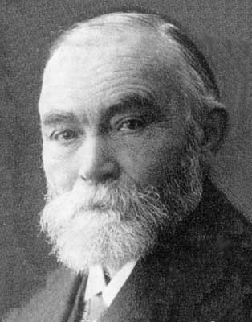
If something is a heap of sand, it remains a heap of sand if you remove one grain of sand from it.
Sandra is a heap of sand.
So, Sandra-minus-one-grain is a heap of sand. (follows from 1 and 2).
So, Sandra-minus-two-grains is a heap of sand. (follows from 1 and 3)
So, Sandra-minus-three-grains is a heap of sand. (follows from 1 and 4)
⋮
1,000,000. So, Sandra-minus-999,998-grains is a heap of sand. (follows from 1 and 999,999)
1,000,001. So, Sandra-minus-999,999-grains is a heap of sand. (follows from 1 and 1,000,000)
“Step 1 is not true, since the word ‘heap’ is vague.”
--Gottlob Frege
(German logician, 1848-1925)

Slide 93
If something is a heap of sand, it remains a heap of sand if you remove one grain of sand from it.
Sandra is a heap of sand.
So, Sandra-minus-one-grain is a heap of sand. (follows from 1 and 2).
So, Sandra-minus-two-grains is a heap of sand. (follows from 1 and 3)
So, Sandra-minus-three-grains is a heap of sand. (follows from 1 and 4)
⋮
1,000,000. So, Sandra-minus-999,998-grains is a heap of sand. (follows from 1 and 999,999)
1,000,001. So, Sandra-minus-999,999-grains is a heap of sand. (follows from 1 and 1,000,000)

Slide 94
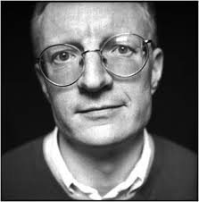
If something is a heap of sand, it remains a heap of sand if you remove one grain of sand from it.
Sandra is a heap of sand.
So, Sandra-minus-one-grain is a heap of sand. (follows from 1 and 2).
So, Sandra-minus-two-grains is a heap of sand. (follows from 1 and 3)
So, Sandra-minus-three-grains is a heap of sand. (follows from 1 and 4)
⋮
1,000,000. So, Sandra-minus-999,998-grains is a heap of sand. (follows from 1 and 999,999)
1,000,001. So, Sandra-minus-999,999-grains is a heap of sand. (follows from 1 and 1,000,000)
“Step 1 is not true: at some point, removing one grain changes the heap to a non-heap. We just aren’t able to know where that point is.”
--Timothy Williamson
(English philosopher, 1955- )

Slide 95
If something is a heap of sand, it remains a heap of sand if you remove one grain of sand from it.
Sandra is a heap of sand.
So, Sandra-minus-one-grain is a heap of sand. (follows from 1 and 2).
So, Sandra-minus-two-grains is a heap of sand. (follows from 1 and 3)
So, Sandra-minus-three-grains is a heap of sand. (follows from 1 and 4)
⋮
1,000,000. So, Sandra-minus-999,998-grains is a heap of sand. (follows from 1 and 999,999)
1,000,001. So, Sandra-minus-999,999-grains is a heap of sand. (follows from 1 and 1,000,000)

Slide 96
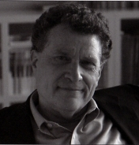
If something is a heap of sand, it remains a heap of sand if you remove one grain of sand from it.
Sandra is a heap of sand.
So, Sandra-minus-one-grain is a heap of sand. (follows from 1 and 2).
So, Sandra-minus-two-grains is a heap of sand. (follows from 1 and 3)
So, Sandra-minus-three-grains is a heap of sand. (follows from 1 and 4)
⋮
1,000,000. So, Sandra-minus-999,998-grains is a heap of sand. (follows from 1 and 999,999)
1,000,001. So, Sandra-minus-999,999-grains is a heap of sand. (follows from 1 and 1,000,000)
“Step 2 is not true: there are no such things as heaps (or tables, or planets, or … etc).”
--Peter Unger
(American philosopher, 1942- )

Slide 97
If something is a heap of sand, it remains a heap of sand if you remove one grain of sand from it.
Sandra is a heap of sand.
So, Sandra-minus-one-grain is a heap of sand. (follows from 1 and 2).
So, Sandra-minus-two-grains is a heap of sand. (follows from 1 and 3)
So, Sandra-minus-three-grains is a heap of sand. (follows from 1 and 4)
⋮
1,000,000. So, Sandra-minus-999,998-grains is a heap of sand. (follows from 1 and 999,999)
1,000,001. So, Sandra-minus-999,999-grains is a heap of sand. (follows from 1 and 1,000,000)
And the correct answer is . . .
?

Slide 98
If something is a heap of sand, it remains a heap of sand if you remove one grain of sand from it.
Sandra is a heap of sand.
So, Sandra-minus-one-grain is a heap of sand. (follows from 1 and 2).
So, Sandra-minus-two-grains is a heap of sand. (follows from 1 and 3)
So, Sandra-minus-three-grains is a heap of sand. (follows from 1 and 4)
⋮
1,000,000. So, Sandra-minus-999,998-grains is a heap of sand. (follows from 1 and 999,999)
1,000,001. So, Sandra-minus-999,999-grains is a heap of sand. (follows from 1 and 1,000,000)
And the correct answer is . . .
???

Slide 99
The End.

